Slide 1





Introduction to Bug Bounty Bootcamp
Embark on an immersive journey into the world of bug bounty hunting. Discover the thrilling art of uncovering vulnerabilities in web applications and software systems, and learn how to responsibly disclose them to earn rewards and recognition.
by Rajendra Shahi

Slide 2

Understanding the Bug Bounty Ecosystem
Defining Bug Bounties
Explore the core concepts of bug bounties, including the role of ethical hackers, bug bounty platforms, and the security landscape they operate in.
Legal and Ethical Considerations
Delve into the importance of adhering to legal guidelines and ethical principles when participating in bug bounty programs.
1
2
3
Bug Bounty Incentives
Understand the motivations and rewards that drive bug bounty hunters, from financial compensation to the thrill of discovery and recognition.

Slide 3
Setting up Your Hacking Environment
Hardware and Software
Cybersecurity Fundamentals
Ethical Hacking Mindset
Gather the necessary tools and software, such as virtual machines, network scanners, and web application testing suites, to create a secure and efficient hacking environment.
Strengthen your understanding of cybersecurity principles, including network protocols, vulnerability assessment, and exploitation techniques, to enhance your bug bounty prowess.
Cultivate the right mindset for ethical hacking, focusing on curiosity, attention to detail, and a commitment to responsible disclosure.

Slide 4

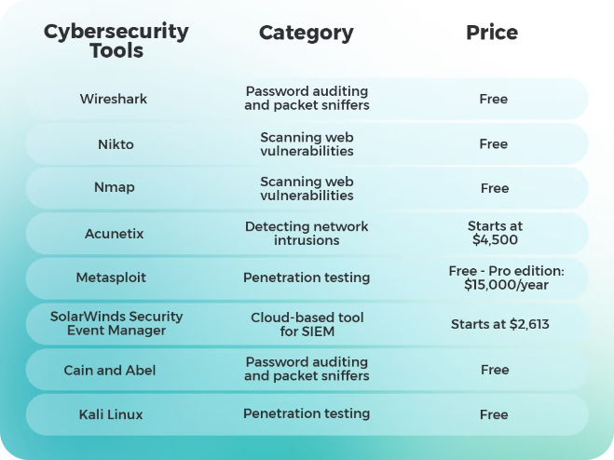
Reconnaissance and Information Gathering
1
Target Identification
2
Passive Information Gathering
Discover and prioritize potential targets, such as websites, web applications, and online services, for your bug bounty hunting.
Utilize techniques like OSINT (Open-Source Intelligence) to gather valuable information about your targets without directly interacting with them.
3
Active Reconnaissance
4
Risk Assessment
Employ active scanning and probing methods to uncover additional details about your targets, while adhering to ethical guidelines.
Analyze the potential risks and impact of your actions, ensuring you operate within the boundaries of the bug bounty program's rules.

Slide 5

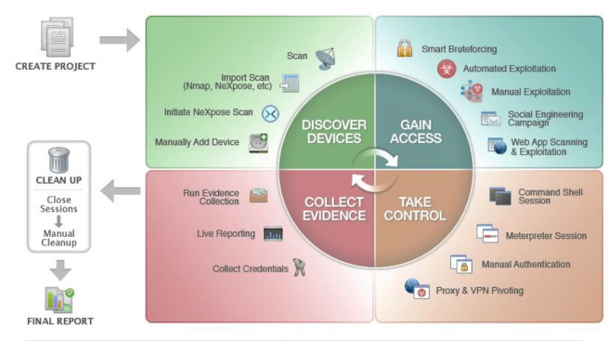
Vulnerability Identification and Exploitation
Web Application Vulnerabilities
Network-based Vulnerabilities
Identify vulnerabilities in network configurations, protocols, and services that could be exploited to gain unauthorized access or disrupt operations.
Detect and understand common web application vulnerabilities, such as SQL injection, cross-site scripting (XSS), and unpatched software.
Exploitation Techniques
Responsible Disclosure
Develop and refine your skills in leveraging various exploitation techniques to demonstrate the impact of the discovered vulnerabilities.
Carefully plan and execute the responsible disclosure of vulnerabilities to the affected parties, following the program's guidelines.

Slide 6



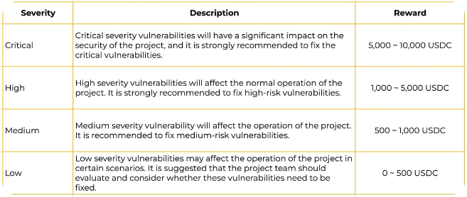


Reporting and Disclosure Techniques
Clear Documentation
Effective Communication
Craft comprehensive and well-structured bug bounty reports, detailing the vulnerability, its impact, and the steps to reproduce it.
Foster positive relationships with bug bounty program managers and developers by maintaining clear, professional, and responsive communication.
Timely Submission
Reward Maximization
Adhere to the program's reporting timelines and guidelines to ensure your findings are addressed in a timely manner.
Understand and follow the program's reward structures to maximize the recognition and compensation for your bug discoveries.

Slide 7


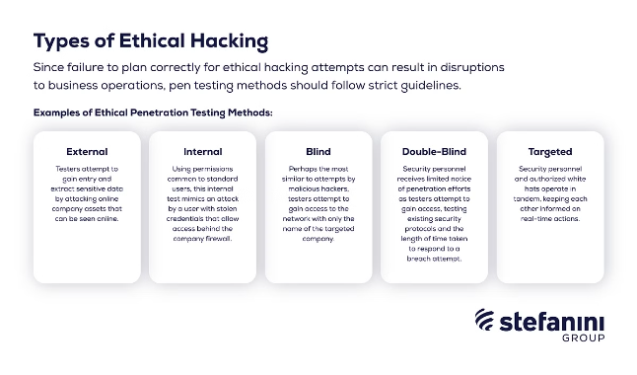


Ethical Hacking Practices
Legal Compliance
Ensure your actions remain within the bounds of the law and the program's rules, avoiding any potential legal repercussions.
Respect for Privacy
Protect the privacy and confidentiality of the organizations and individuals involved in the bug bounty program.
Responsible Disclosure
Commit to the responsible and ethical disclosure of vulnerabilities, prioritizing the safety and security of the affected systems.

Slide 8
Monetizing Your Bug Bounty Efforts
Financial Rewards
Career Advancement
Personal Growth
Explore the various financial incentives offered by bug bounty programs, including cash rewards, bounties, and opportunities for long-term engagements.
Leverage your bug bounty experiences to build a reputation, network with industry professionals, and potentially secure lucrative job opportunities.
Recognize the intrinsic value of bug bounty hunting, including the personal satisfaction, skill development, and the chance to contribute to the security of the digital landscape.

Slide 9

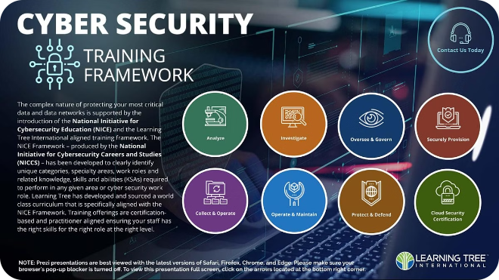
Continuous Learning and Skill Development
1
Stay Curious and Adaptable
Cultivate a mindset of continuous learning, staying up-to-date with the latest security trends, tools, and techniques to maintain a competitive edge.
2
Expand Your Knowledge Base
Engage in online courses, workshops, and cybersecurity communities to deepen your understanding of web application security, network protocols, and emerging threats.
3
Leverage Mentorship
Seek out experienced bug bounty hunters and security professionals who can provide guidance, share their insights, and help you navigate the ever-evolving landscape.

Slide 10

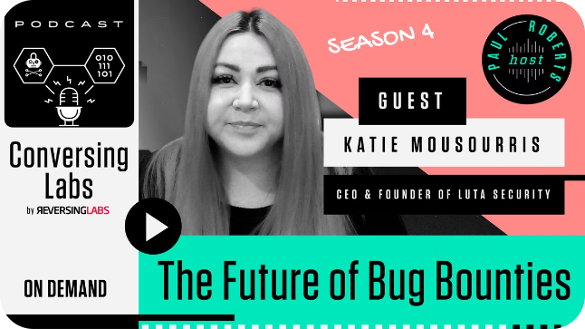
Conclusion and Next Steps
1
Embrace the Challenge
2
Join the Community
The bug bounty bootcamp has equipped you with the knowledge and skills to embark on an exciting journey as an ethical hacker. Embrace the challenge and continue to push your boundaries.
Connect with other bug bounty hunters, security enthusiasts, and industry professionals to share experiences, collaborate on projects, and stay informed about the latest developments.
3
Contribute to a Safer Digital World
Recognize the impact you can make by uncovering vulnerabilities and helping organizations strengthen their security posture, ultimately contributing to a more secure digital landscape for all.

